Slide 1
Wie klingt die Maschine am Umrichter?
Schnelle Berechnung und Auralisierung des Körperschalls
mOre driVE 2021
September 1st, 2021
Martin Hanke, Jürgen Wibbeler,
CADFEM GmbH, Berlin

Slide 2
Agenda
Problem Description
State of the Art: Harmonic Workflow
Pros and Cons of Harmonic Workflow
Transient System Simulation to Generate Structure Borne Sound
  ECE Generation Including Force Waves
  Look Up Table in Twin Builder for Force Waves
  SPMWRITE to Create Housing ROM
PMSM under SIN and PWM Excitation, Waterfall Diagram
Summary, Outlook, Potential Customer Benefit

Slide 3
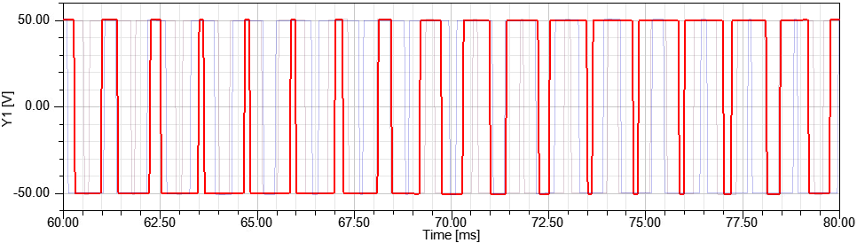
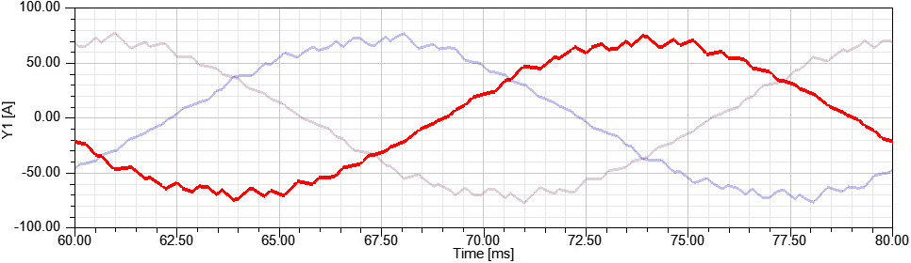
Problem Description
NVH from electromagnetic forces becomes increasingly important for traction motors, especially BEV and HEV
NVH depends upon motor, housing, surrounding structure, mechanical connections
Other sources (gearbox, bearings…) to be included
Drive scenarios with fast changing operating conditions, i.e. no steady-state
High frequency electric non-periodic PWM-signals
generated by inverter circuits
(PWM = Pulse Width Modulation)
Phase Voltage
Phase Current
Ripple

Slide 4
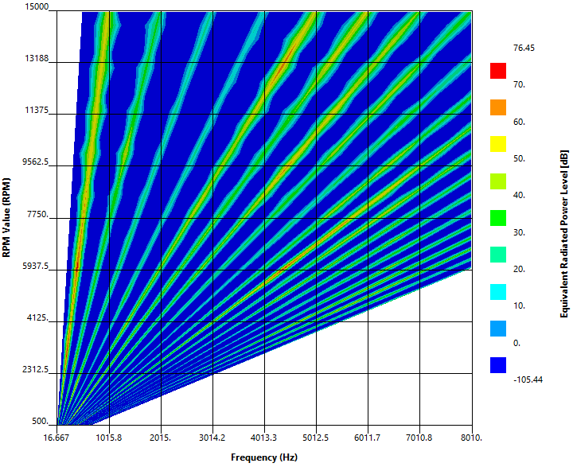
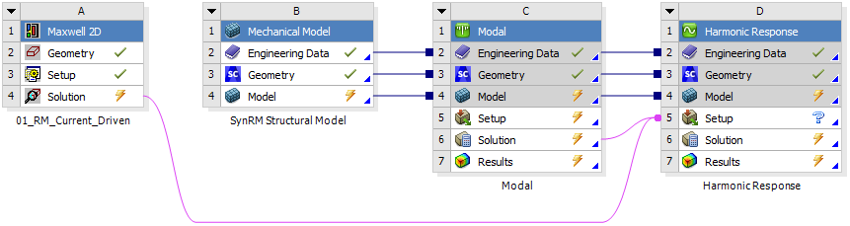
State of the Art: Harmonic Workflow
Maxwell 2D or 3D
transient analysis:
Provides air gap
excitation forces
Harmonic Response
analysis:
Provides steady-state
ERP-spectrum
Modal analysis for
mode superposition
Maxwell-Mechanical Harmonic Force Link:
➔ Transfer of excitation forces at stator teeth
(steady-state periodic) including DFT
ERP-Level Waterfall Plot:
ERP-spectrum vs. motor speed

Slide 5
Pros and Cons of Harmonic Workflow
Pros:
FEM-based structure-borne and air-borne acoustical Waterfall calculation
Frequency-domain solution reduces structural and acoustical CPU-demands
Cons:
Calculates discrete operating points at steady state only; no transient scenarios
Requires periodic excitation loads
Hard to combine excitations from different sources (motor, inverter, gearbox, …) due to required total periodic intervals
Full FEM-based electromagnetics not suitable for high frequency PWM-signals
(Required time stepping defined by Nyquist-Shannon criterion!)

Slide 6
Idea: System Simulation for fast Transient NVH Analysis
System simulation for car dynamics is well known
System simulation for EM noise is new
Vibrating Structure
Surface Velocity
Noise
Forces
Power Electronics
Current,
Voltage
Electric Machine
Speed,
Torque
Car Kinematics

Slide 7
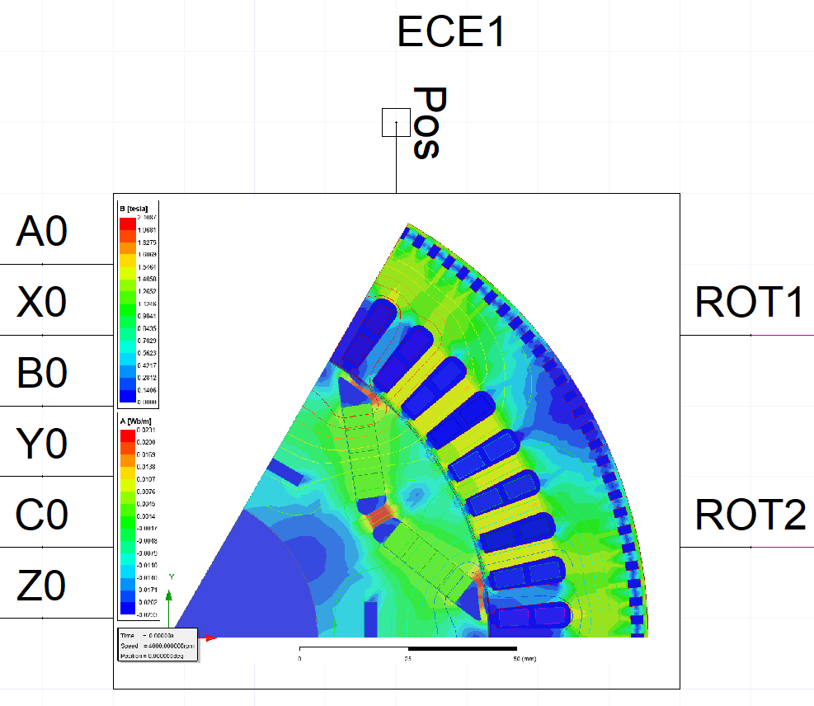
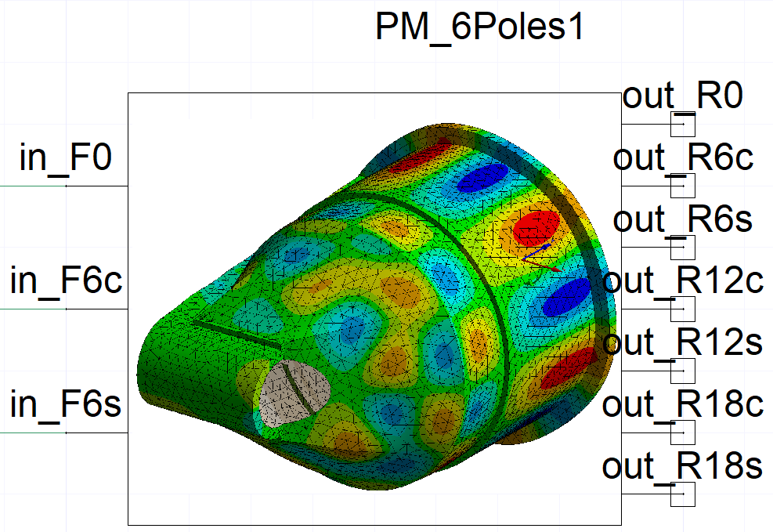
Transient System Simulation to Generate Structure Borne Sound (SBS)
Power electronics and control algorithms are regularily used in Ansys Twin Builder. For SBS generation reduced order models (ROMs) are needed for three different purposes:
  Electric machine: ECE (equivalent circuit extraction) exported from Ansys Maxwell models have look up tables for torque and flux linkage vs. angle and currents. ECE provides full conservative electromagnetic – rotational interaction.
  Air gap field creates forces onto stators beeing dependent on angle and currents. Transfering forces into force waves using spatial Fourier transformation is done using the field calculator inside Maxwell. The causal relation from angle and currents to force wave coefficients gives the connection to structural mechanics, interpolation is done with n-dimensional table from Twin Builder.
  Vibrating structure can be reduced to a modal basis. For input and output of a causal state space model load vectors describing input force waves and output surface normal waves are appended to the modal file. Ansys Mechanical produces the intended state space model.

Slide 8
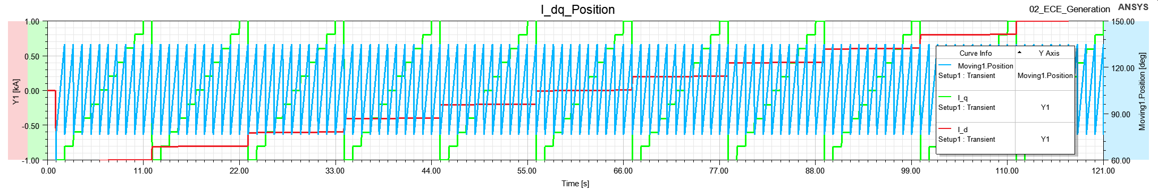
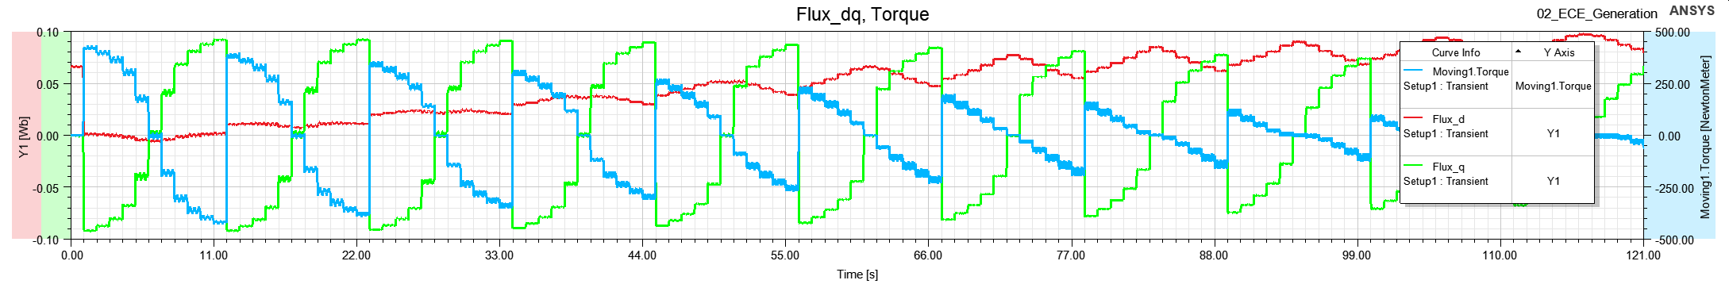
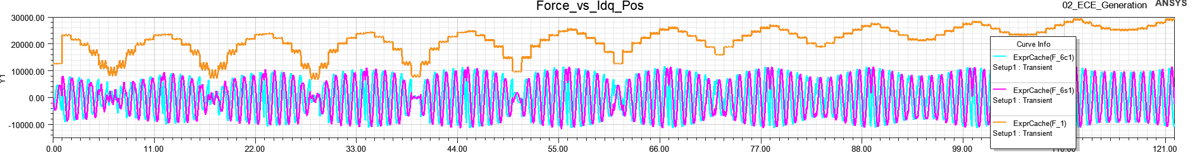
ECE Generation Including Force Waves
Create ECE using ECE3 and ECER models
Add Expression Cache for Force Waves

Slide 9
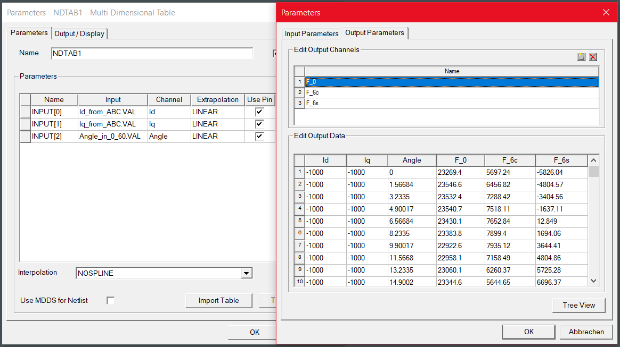
Look Up Table in Twin Builder for Force Waves
From (cleaned and completed) force wave export to NDTAB

Slide 10
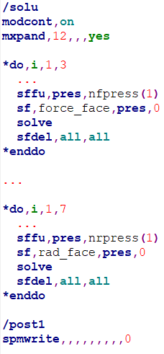
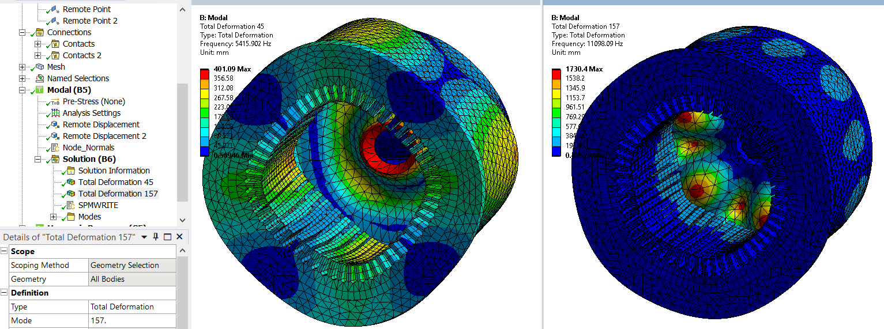
SPMWRITE to Create Housing ROM
Apply excitation and radiation force patterns as additional
load vectors to modal file .mode
Export state space matrices using SPMWRITE, transfer to SML

Slide 11
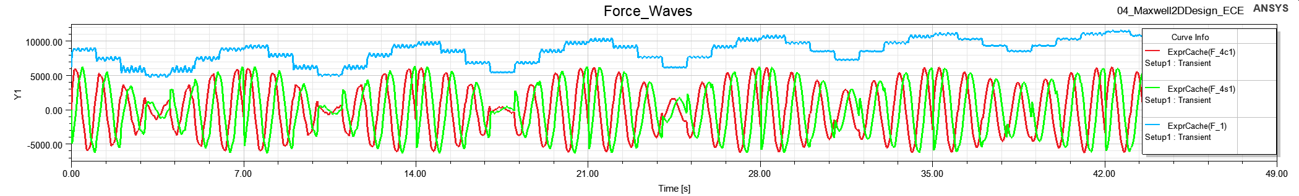
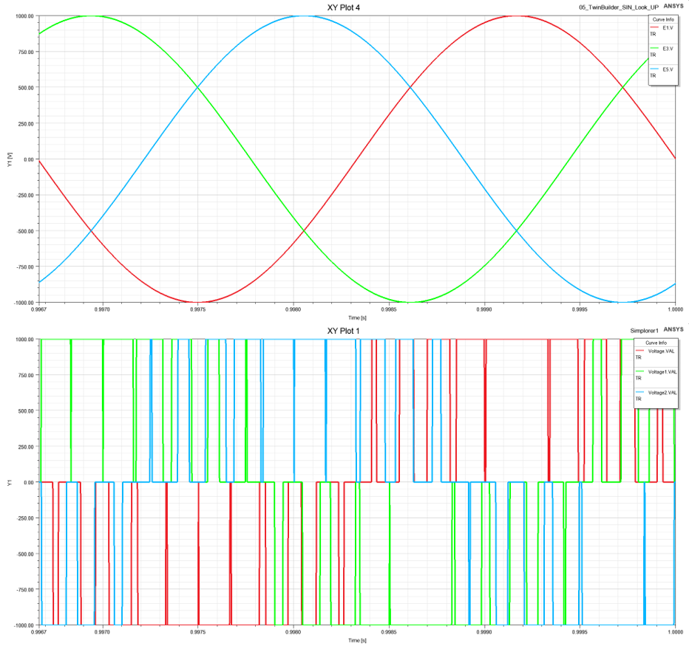

Example: PMSM under SIN and PWM Excitation
Vibrating Structure
Surface Velocity
Noise
Input frequency ramped to 900 Hz Speed ramped to 18000 RPM
PWM frequency 6000 Hz
Id and Iq are functions of
ECE.pos and currents
3DTAB finds force wave coefficients
Causal ROM transfers to surface waves
Sum of surface velocities times impedance gives sound pressure
Forces
Power Electronics
Electric Machine
Car Kinematics
Current,
Voltage
Speed,
Torque
SIN PWM

Slide 12
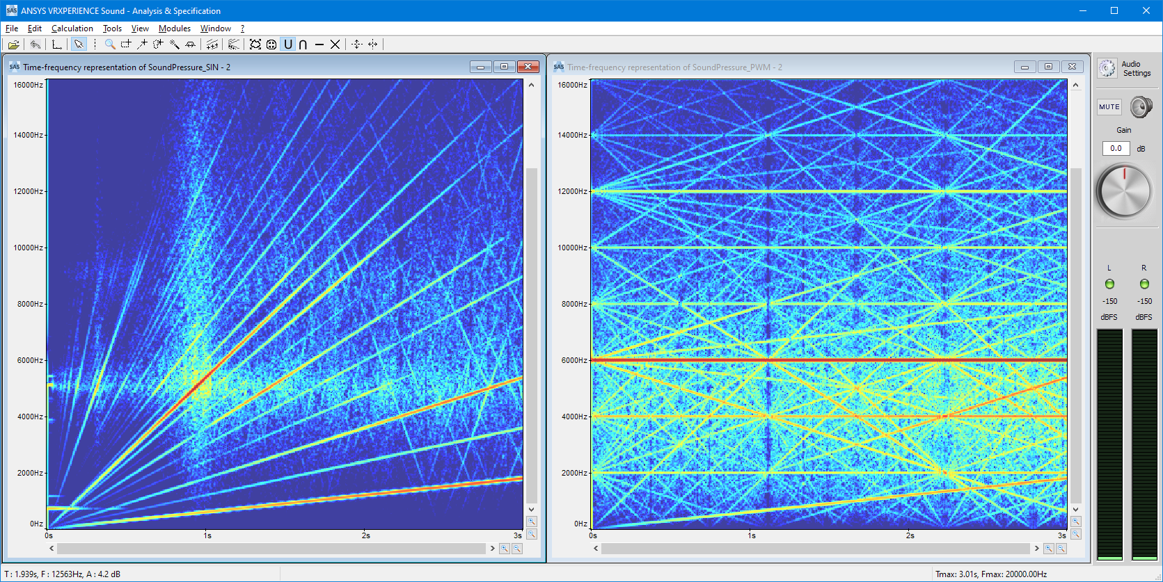
Waterfall Diagram Comparison SIN vs PWM
Linear speed increase: in 3 s from 0 to 18000 RPM
PWM Frequency
6000 Hz
Eigen-mode 5500 Hz
Normalized Sound Pressure Levels

Slide 13
Summary, Outlook, Benefit
Proof of Concept: Transient Structure Based Sound from Arbitrary Excitation
  Electromagnetic and structure domain are transferred to reduced order models
  Coupling using air gap force waves allows transient solution in system simulator
  Fast assessment of structure born sound to compare excitation schemes, structural couplings, local damping effects
For inclusion of air acoustics
  Generation of acoustic transfer function from surface normal modes to human ear
The sound experience can be modeled and tuned in early stage of drive development
  PWM excitation
  Gear meshing
  Concentrated nonlinearities like contact bounces

